Slide 1
Multiplying Binomials and Trinomials
Integrated mathematics

Slide 2
Objectives
Students will multiply a binomial with a trinomial through the application of the distributive property.

Slide 3

Example 1
$$(x+1)(x^{2}+x+1)$$

Slide 4

Example 2
$$(x^{2}+4)(x^{2}+2x−3)$$

Slide 5
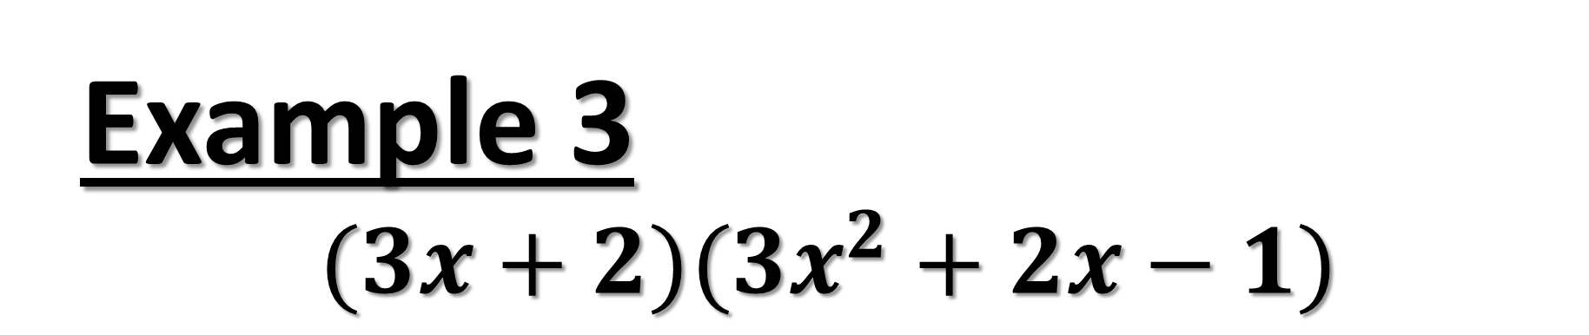
Example 3
$$(3x+2)(3x^{2}+2x−1)$$

Slide 6

Example 4
$$(3c−4)({2c}^{2}−c+3)$$

Slide 7
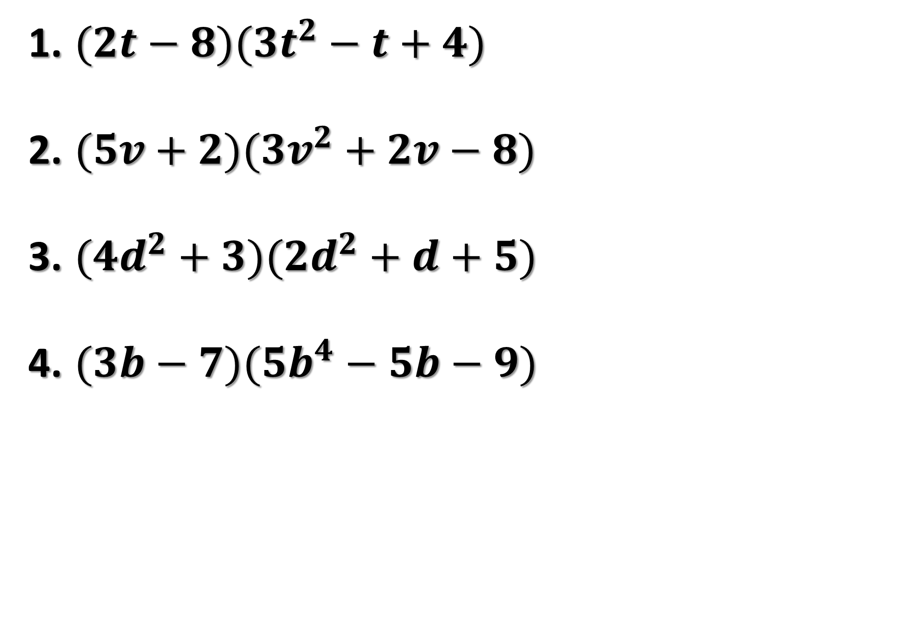
Try on your own
$(2t−8)({3t}^{2}−t+4)$
$(5v+2)({3v}^{2}+2v−8)$
$({4d}^{2}+3)({2d}^{2}+d+5)$
$(3b−7)({5b}^{4}−5b−9)$

